Slide 1
Teams

Slide 2
Success Factors
Stages
Unity

Slide 3
Group vs. Team

Slide 4
Success Factors
What makes a successful team? How does the environment/people affect this?
Notes:
Small number of people
Complementary skills
Common purpose
Specific performance goals
Common approach
Culture of learning

Slide 5
Stages of a Team
4 stages: forming, storming, norming & performing

Slide 6
Unity
Organic Unity
Growth

Slide 7
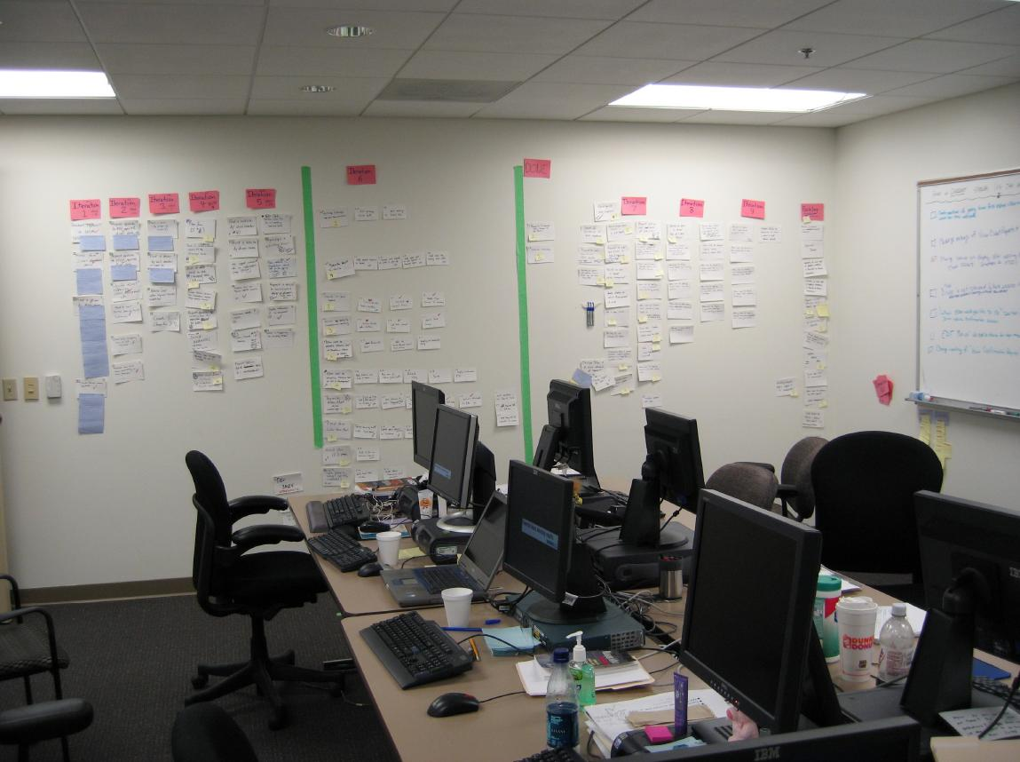

Slide 8
Discussion on
Team Unity
What is an example of a united team? How did the team members behave?

Slide 9
O
Notes:
Any questions or comments?

